Slide 1
Principal Component Analysis
May 2022

Slide 2
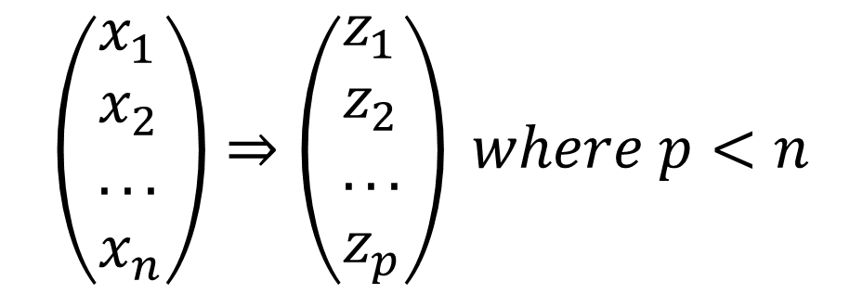
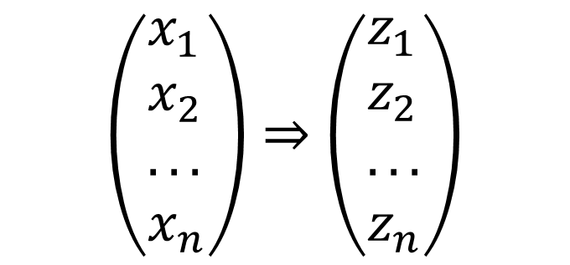
Principal Component Analysis
The central idea of principal component analysis (PCA) is to reduce the dimensionality of a data set consisting of a large number of interrelated variables, while retaining as much as possible of the variation present in the data set. This is achieved by transforming to a new set of variables, the principal components (PCs), which are uncorrelated, and which are ordered so that the first few retain most of the variation present in all of the original variables.
PCs
PCs
$$\left(\begin{aligned}&x_{1} \\ &x_{2} \\ &... \\ &x_{n}\end{aligned}\right)⇒\left(\begin{aligned}&z_{1} \\ &z_{2} \\ &... \\ &z_{n}\end{aligned}\right)$$
$$\left(\begin{aligned}&x_{1} \\ &x_{2} \\ &... \\ &x_{n}\end{aligned}\right)⇒\left(\begin{aligned}&z_{1} \\ &z_{2} \\ &... \\ &z_{p}\end{aligned}\right) where p<n$$

Slide 3
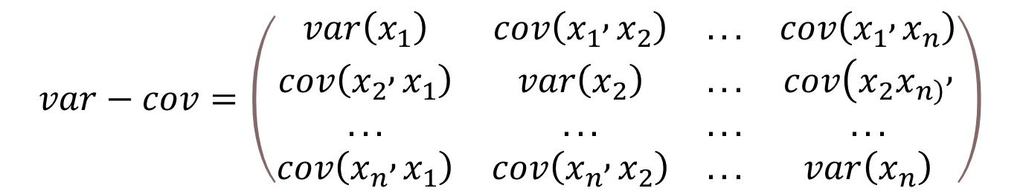
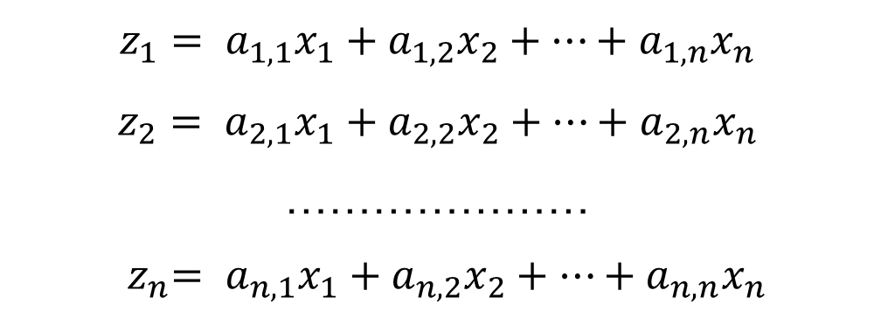
Calculation of Principal Components
Suppose that $x$ is a vector of $n$ random variables, and whose covariance matrix has the following structure:
$$var−cov=\left(\begin{matrix}var\left(x_{1}\right) & cov\left(x_{1} , x_{2}\right) & ... & cov\left(x_{1} , x_{n}\right) \\ cov\left(x_{2} , x_{1}\right) & var\left(x_{2}\right) & ... & cov(x_{2}x_{\left.n\right)}, \\ ... & ... & ... & ... \\ cov\left(x_{n} , x_{1}\right) & cov\left(x_{n} , x_{2}\right) & ... & var\left(x_{n}\right)\end{matrix}\right)$$
$$z_{1}= a_{1,1}x_{1}+a_{1,2}x_{2}+…+a_{1,n}x_{n}$$
$$z_{2}= a_{2,1}x_{1}+a_{2,2}x_{2}+…+a_{2,n}x_{n}$$
…………………
$${ z}_{n}= a_{n,1}x_{1}+a_{n,2}x_{2}+…+a_{n,n}x_{n}$$

Slide 4
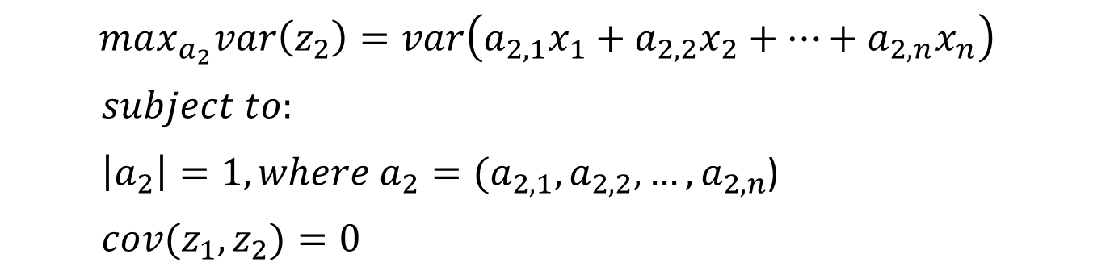
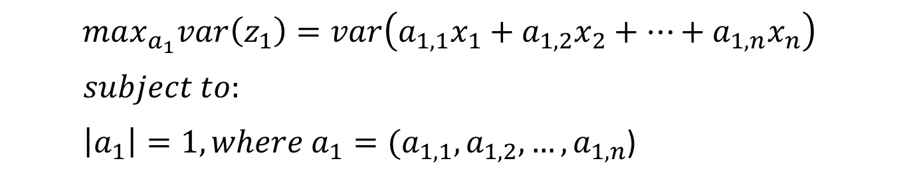


Calculation of Principal Components
$$max_{a_{1}}var\left(z_{1}\right)=var\left(a_{1,1}x_{1}+a_{1,2}x_{2}+…+a_{1,n}x_{n}\right)$$
$$subject to:$$
$\left|a_{1}\right|=1, where {a_{1}=(a}_{1,1}, a_{1,2}, …,a_{1,n}$)
$$PC1⇒$$
$$max_{a_{2}}var\left(z_{2}\right)=var\left(a_{2,1}x_{1}+a_{2,2}x_{2}+…+a_{2,n}x_{n}\right)$$
$subject to:$
$\left|a_{2}\right|=1, where {a_{2}=(a}_{2,1}, a_{2,2}, …,a_{2,n}$)
$cov(z_{1},z_{2})=0$
$$PC2⇒$$

Slide 5
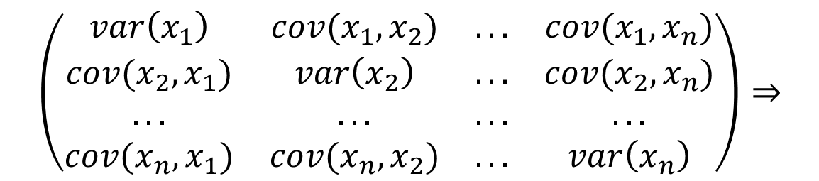

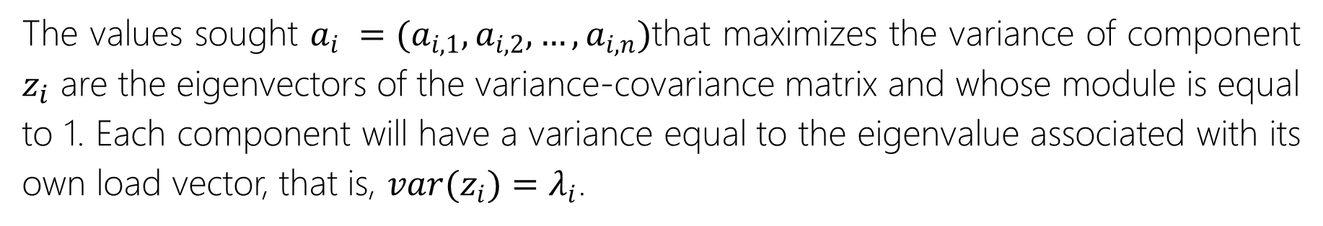


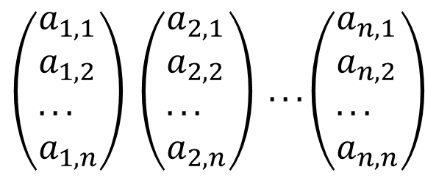
Calculation of Principal Components
The values sought $a_{i} =(a_{i,1},a_{i,2},…,a_{i,n})$that maximizes the variance of component $z_{i}$ are the eigenvectors of the variance-covariance matrix and whose module is equal to 1. Each component will have a variance equal to the eigenvalue associated with its own load vector, that is, $var(z_{i})=λ_{i}$.
eigenvalues
$$λ_{1}$$
$$λ_{2}$$
$$λ_{n}$$
$$\left(\begin{matrix}var\left(x_{1}\right) & cov(x_{1},x_{2}) & ... & cov(x_{1},x_{n}) \\ cov(x_{2},x_{1}) & var\left(x_{2}\right) & ... & cov(x_{2},x_{n}) \\ ... & ... & ... & ... \\ cov(x_{n},x_{1}) & cov(x_{n},x_{2}) & ... & var\left(x_{n}\right)\end{matrix}\right)⇒$$
$$\left(\begin{aligned}&a_{1,1} \\ &a_{1,2} \\ &... \\ &a_{1,n}\end{aligned}\right) \left(\begin{aligned}&a_{2,1} \\ &a_{2,2} \\ &... \\ &a_{2,n}\end{aligned}\right) ...\left(\begin{aligned}&a_{n,1} \\ &a_{n,2} \\ &... \\ &a_{n,n}\end{aligned}\right)$$
eigenvectors

Slide 6
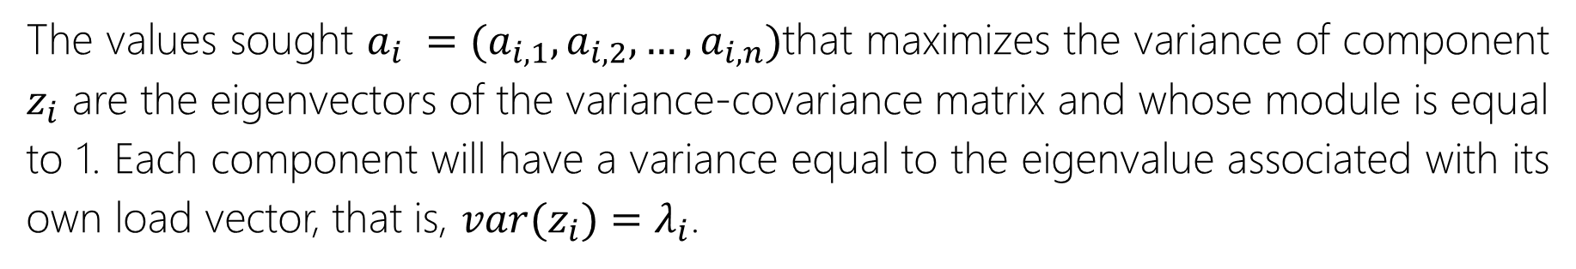
Calculation of Principal Components
The values sought $a_{i} =(a_{i,1},a_{i,2},…,a_{i,n})$that maximizes the variance of component $z_{i}$ are the eigenvectors of the variance-covariance matrix and whose module is equal to 1. Each component will have a variance equal to the eigenvalue associated with its own load vector, that is, $var(z_{i})=λ_{i}$.
eigenvalues
$$λ_{1}$$
$$λ_{2}$$
$$λ_{n}$$
$$\left(\begin{matrix}var\left(x_{1}\right) & cov(x_{1},x_{2}) & ... & cov(x_{1},x_{n}) \\ cov(x_{2},x_{1}) & var\left(x_{2}\right) & ... & cov(x_{2},x_{n}) \\ ... & ... & ... & ... \\ cov(x_{n},x_{1}) & cov(x_{n},x_{2}) & ... & var\left(x_{n}\right)\end{matrix}\right)⇒$$
$$\left(\begin{aligned}&a_{1,1} \\ &a_{1,2} \\ &... \\ &a_{1,n}\end{aligned}\right) \left(\begin{aligned}&a_{2,1} \\ &a_{2,2} \\ &... \\ &a_{2,n}\end{aligned}\right) ...\left(\begin{aligned}&a_{n,1} \\ &a_{n,2} \\ &... \\ &a_{n,n}\end{aligned}\right)$$
eigenvectors

Slide 7
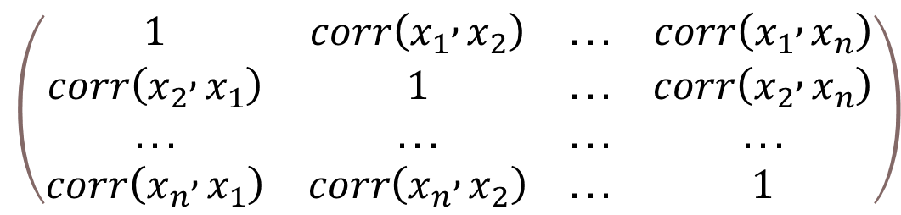
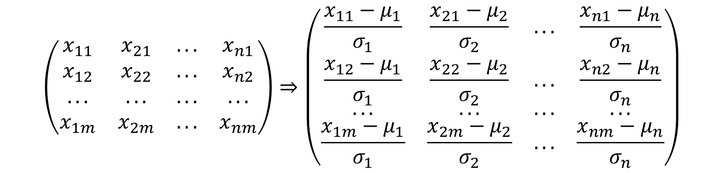
PCA with Correlation Matrix
$$\left(\begin{matrix}x_{11} & x_{21} & ... & x_{n1} \\ x_{12} & x_{22} & ... & x_{n2} \\ ... & ... & ... & ... \\ x_{1m} & x_{2m} & ... & x_{nm}\end{matrix}\right)⇒\left(\begin{matrix}\frac{x_{11}−μ_{1}}{σ_{1}} & \frac{x_{21}−μ_{2}}{σ_{2}} & ... & \frac{x_{n1}−μ_{n}}{σ_{n}} \\ \frac{x_{12}−μ_{1}}{σ_{1}} & \frac{x_{22}−μ_{2}}{σ_{2}} & ... & \frac{x_{n2}−μ_{n}}{σ_{n}} \\ ... & ... & ... & ... \\ \frac{x_{1m}−μ_{1}}{σ_{1}} & \frac{x_{2m}−μ_{2}}{σ_{2}} & ... & \frac{x_{nm}−μ_{n}}{σ_{n}}\end{matrix}\right)$$
$$\left(\begin{matrix}1 & corr\left(x_{1} , x_{2}\right) & ... & corr\left(x_{1} , x_{n}\right) \\ corr\left(x_{2} , x_{1}\right) & 1 & ... & corr\left(x_{2} , x_{n}\right) \\ ... & ... & ... & ... \\ corr\left(x_{n} , x_{1}\right) & corr\left(x_{n} , x_{2}\right) & ... & 1\end{matrix}\right)$$

Slide 8
PCA with Correlation Matrix
PCA <- prcomp(x = BaseAumentada, center = TRUE, scale. = TRUE)
summary(PCA)
PCs <- data.frame(
PC1=PCA[["x"]][,1],
PC2=PCA[["x"]][,2],
PC3=PCA[["x"]][,3],
PC29=PCA[["x"]][,29],
PC30=PCA[["x"]][,30]
)
plot(x = PCs$PC1, y=PCs$PC2)
scatterplot3d(x = PCs$PC1, y=PCs$PC2, z = PCs$PC3)
plot(x = PCs$PC29, y=PCs$PC30)
plot(x = PCs$PC1, y=PCs$PC30)

Slide 9
Caso de Estudio
Una institución financiera quiere determinar qué clientes son más propensos a incurrir en el crimen de lavado de dinero. Aquellos clientes con un riesgo alto serán sujetos a investigaciones más profundas.

Slide 10
Questions?

